Slide 1
ICT & Software Engineering
03– Classes & Objects
Intro Classes & Objects

Slide 2

Content
Topics of this lecture
Q&A
Switch & do…while-statements
Introduction to Classes & Objects
Starting from this lecture we will Visual Studio with a Windows Forms App

Slide 3

Question about last lecture?
Types
Simple types
List<T>
Array
Operators
Arithmetic operators
Relational operators
Conditional statements
if-statement
switch-statement
Repetition statements
for-statement
while-statement
foreach-statements
Switch and do...while statement remaining

Slide 4
Switch statement - Example
Alternative to a if-statement
int maxLoad;
String typeProduct;
switch(typeTruck)
{
case "DAF": maxLoad = 25; typeProduct = "food"; break;
case "Mercedes": maxLoad = 50; typeProduct = "non-fragile"; break;
case "MAN": maxLoad = 100; typeProduct = "small"; break;
default: maxLoad = 0; typeProduct = ""; break;
}

Slide 5
Syntax and semantics
switch(<expression>)
{
case <value_1>: <statements_1>; break;
case <value_2>: <statements_2>; break;
case <value_3>: <statements_3>; break;
default: <statements_default>; break;
}
First calculate <expression>.
If it is equal to <value_1>: perform <statements_1> and skip all other statements. If it is equal to <value_2>: perform <statements_2> and skip all other statements. etc.
In case it is not equal to any value <value_1>, <value_2>, <value_3>, etc, perform <statements_default> if there is a "default" (otherwise do nothing).

Slide 6
Extra information
If there is no break, the switch statement falls through
int maxLoad;
string typeProduct;
switch(typeTruck)
{
case "DAF": maxLoad = 25; typeProduct = "food"; break;
case "Mercedes":
case "MAN": maxLoad = 100; typeProduct = "small"; break;
default: maxLoad = 0; typeProduct = ""; break;
} //in case of both "Mercedes" or "MAN", the maxLoad will be 100

Slide 7
Extra information
Similarity with if-statement
string typeProduct;
if(kind == 'r')
{
typeProduct = "food";
} else if(kind == 'p')
{
typeProduct = "non-fragile";
} else if(kind == 'v')
{
typeProduct = "small";
} else
{
typeProduct = "any";
}
string typeProduct;
switch(kind)
{
case 'r': typeProduct = "food"; break;
case 'p': typeProduct = "non-fragile"; break;
case 'v': typeProduct = "small"; break;
default: typeProduct = "any"; break;
}

Slide 8
Do...while-statement
Variation of the while-statement
Syntax:
Example:
do
{
<statements>
//To exit the loop, the condition should evaluate to false
} while (<boolean_expression>);
int sum = 2; do
{
sum = sum * 3;
} while (sum < 100);

Slide 9
while vs do…while
What is the difference?
int sum = 2;
while (sum < 2)
{
sum = sum * 3;
}
int sum = 2; do
{
sum = sum * 3;
} while (sum < 2);
VS
int sum = 2;
while (sum < 6)
{
sum = sum * 3;
}
int sum = 2; do
{
sum = sum * 3;
} while (sum < 6);
VS

Slide 10

Questions?

Slide 11

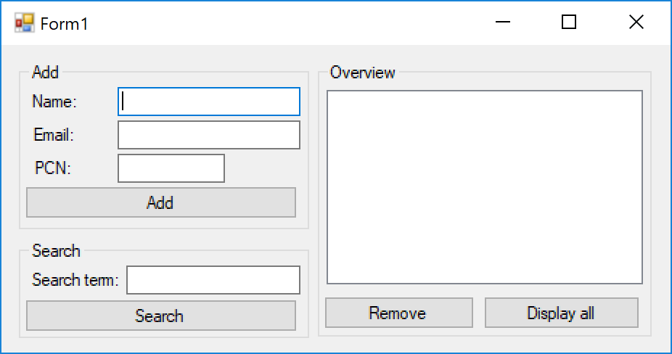
Intro: How would you?
How would we implement this???

Slide 12
Intro: Entities
An application usually has one or more entities with a ‘common’ set of data and actions
The actual values per student are probably different, but there are commonalities
This example has an entity Student with
Data representing: name, email, PCN, etc.
Actions to: initialize student with data, modify the data, show data as one string, etc.

Slide 13
Intro: Classes & objects
Implementing entities requires two things
First define a class describing an entity.
For example:
A student has name, email and PCN
Represent the student data as one string
Change the name of a student
Then create an object representing the actual entity
For example:
A student has the name John Doe, email j.doe@fontys.nl and PCN 123456
The data as single string is John Doe with PCN 123456
Change the name to Jane Doe

Slide 14
Intro: Classes & objects (cont.)
In other words:
A class functions a blueprint (schematic), containing variables (called instance variables or fields) and methods
An object is an instance of a class (“thing” created using the blueprint) which can be used in the application
First step into object oriented programming to create maintainable and extendable code

Slide 15

Examples
Define a class:
Create an object:
public class Student
{
//instance variables
//methods
}
Student studentA;
studentA = new Student();

Slide 16

Syntax
Define a class:
Create an object:
public class <class_name> //identifier
{
//instance variables
//methods
}
Also called class members
<class_name> <identifier>; //Declare a class/object variable
<identifier> = new <class_name>(); //create an object

Slide 17
Intermezzo: Access Modifiers
In the previous examples, the class started with the public keyword
This is an access modifiers and allows you to control the ‘accessibility’
For now: public & private
You might want to make some information available only under certain constraints
For example, your balance should be only modified under secure conditions and should not be accessible from other accounts

Slide 18
Syntax
Method accessible from inside and outside the class
Instance variable accessible only from within the class
public void DepositMoney(double amount)
{
//body of the method
this.balance = this.balance + amount;
}
private double balance;

Slide 19
Questions?

Slide 20

Extra information
Access modifiers can be applied to all members of a class
Instance variables
Methods
Properties
Etc.
There are other values for access modifiers (covered in future courses).

Slide 21
Class Members
Instance variables & methods

Slide 22
Examples
public class Student
{
private string name;
private string email;
public int PCN;
// Extra code
}
This is not the desired way. Keep instance variables private. To access them, use methods (introduced next).
Student studentA = new Student();
studentA.PCN = 123456;

Slide 23
Syntax
Instance variable definition
Variable assignment in a class
Variable assignment outside of the class (using the object)
<type> <variable_name>;
this.<variable_name> = <correct_value>;
<object_identifier>.<variable_name> = <correct_value>;

Slide 24
Extra information – Variables
Instance variables should follow the naming conventions of variables.
Best practice: keep instance variables private, unless there is a good reason not to do so.

Slide 25
Examples
When no parameters, add empty parentheses.
public void SetName(string newName)
{
//body of the method
}
Student studentA = new Student();
studentA.SetName("John Doe");

Slide 26
Syntax
Create a method
Call a method
public <return_type> <method_name>(<list_of_parameters>)
{
//body of the method
//statements of the method
}
<object_identifier>.<method_name>(<list_of_arguments>);

Slide 27
Extra information - Methods
Use verbs in the naming of a method (i.e. it represents an action)
The compiler knows the difference between a field and a method by detecting whether the identifier of the member is followed by a pair of parentheses.
Best practice: keep methods public, unless there is a good reason not to do it.

Slide 28
Complete example
public class Student
{
// Instance variables: Store data
private string name;
private string email;
private int PCN;
// More will be added later
// Methods: Make use if the instance variables
public void SetName(string newName)
{
if(newName != "")
{ this.name = newName; }
}
public string GetInfo()
{ return this.name + " with PCN " + this.PCN.ToString(); }
}
Student studentA;
studentA = new Student();
studentA.SetName("John Doe");
lblInfo.Text = studentA.GetInfo();

Slide 29
Examples (cont.)
studentA
studentB
name: "John Doe"
email: ""
PCN: 0
name: ""
email: ""
PCN: 0
What will be shown in the MessageBox?
public string GetInfo()
{ return this.name + " with PCN " + this.PCN.ToString(); }
Student studentA = new Student();
Student studentB = new Student();
studentA.SetName("John Doe");
MessageBox.Show(studentB.GetInfo());

Slide 30
Questions?

Slide 31
Classes: How to
How to determine what should be defined in a class?
Ask yourself the following questions:
What entities do I need to represent in my application?
For each entity:
What kind of information is required for this entity?
What type of data is it?
What kind of actions can be performed with this entities data?
Do these actions have certain constraints?
How does it relate to other entities?
Does one ‘own’/use the other?
Key takeaway: First determine what needs to be achieved, then write code

Slide 32

Demo
Create an app for Bank Account.
What kind of information is required for an account?
Should this information be available to everybody?
What kind of actions can be performed with an account?
Do these actions have certain constraints?

Slide 33
Did you noticed?
public partial class Form1 : Form {
public Form1() { InitializeComponent(); }
private void BtnChangeColor_Click(object sender, EventArgs e) { if (this.BackColor == Color.Gray) { this.BackColor = Color.Purple; } else if (this.BackColor == Color.Purple) { this.BackColor = Color.Green; } else if( this.BackColor == Color.Green ) { this.BackColor = Color.Gray; } else { this.BackColor = Color.Red; } }
}

Slide 34
Extra information
Define a class in its own file (having the same name as the class)
Class Person is defined in the file Person.cs
Class names should start with a capital letter and use PascalCase.
Object names should follow the naming conventions of variables.
One common exception when using objects is NullPointerException
Occurs when accessing an object that is defined, but not created.
Student alice;
alice = new Student();
alice.SetName("Alice");
Student alice;
alice.SetName("Alice");
Student alice = new Student();
alice.SetName("Alice");

Slide 35

Practice: Step 1/2
You need to make an application to store and show pet information
The user should be able to input the following:
Pet name, birth year and type (dog, cat, fish or hamster).
Create a class for this
And make sure you only have private instance variables & public (set) methods

Slide 36
Practice: Step 2/2
You need to make an application to store and show pet information
The user should be able to input the following:
Pet name, birth year and type (dog, cat, fish or hamster).
The application should be able to output the following:
Age of the pet
All info, for example: Bob the Dog (5 years old) or Max the Cat (11 years old), etc.
Extend the created class
and make sure you only have private instance variables & public methods

Slide 37

What to do next?
Start working on the practical

Slide 38
Part2 - Practical
See canvas for Quiz & practical assignments

Slide 39
Part 3
Synthesis

Slide 40
Questions about practical?

Slide 41
Practice together
Create an application to enter letter grades and view statistics about it
With your application a user can:
Add multiple students with their name, student number and letter grade (i.e. O, G, S or U)
See added students with their letter grade(s) e.g. Jane Adams (U) or John Doe (S, S, G) or etc.
Done? View statistics about:
Amount of students passed
Amount of students failed
Percentage of each letter grade e.g. U: 20%, S: 50%, G: 23%, O: 7%
Technical constraints
Create and use at least one class (Student)
Up for a challenge? Make use of two classes (GradeAdminstration & Student)

Slide 42

Summary
After this lecture you can:
Define a class with its members
Create an object of a class-type
Declare and use the fields necessary to store data
Define the methods to operate on the objects

